Slide 1

COMPETITION ANALYSIS & BUSINESS STRATEGY

Slide 2
Table of contents
Executive Summary
Global Benchmarking
Local Competition
SWOT Analysis
Market Gaps
Justified Premiums
Strong Credibility
Keep it recurring
Business Model
Go-to Timeline
11. Financial Projections
12. Conclusion
EMPOWERING BUSINESSES

Slide 3
EXECUTIVE SUMMARY
ETQAN ACADEMY is a premier real estate training institute designed to equip aspiring and experienced professionals with industry-leading knowledge, certifications, and practical skills. Inspired by successful models globally, Etqan Academy provides a localized, high quality alternative tailored solution for this market’s business needs.
What is the market opportunity here?
The real estate sector is growing rapidly, yet many professionals lack structured, accredited training hence standardized market and capabilities among the industry’s professionals.
Existing programs are either too theoretical, outdated, or expensive. Etqan Academy fills this gap by offering: ✔ Practical, hands-on courses (sales, marketing, investment, property management, etc.). ✔ Government & industry-recognized certifications. ✔ Flexible learning (online, hybrid, in-person). ✔ Affordable pricing compared to international competitors.
EMPOWERING BUSINESSES

Slide 4
EXECUTIVE SUMMARY
VISION
MISSION
To become the leading real estate academy in the Egypt then the region, to have an excellent reputation for the content and the credits we provide for the professionals that shall be recognized for excellence in education and industry impact.
To empower real estate professionals through comprehensive, practical, and accredited training programs that enhance expertise, compliance, and career success. Also, to make Egypt a more standardized marketplace in terms of professionals and reporting.
EMPOWERING BUSINESSES

Slide 5

EXECUTIVE SUMMARY
Competitive Edge:
Local Expertise: Courses adapted to regional laws, market trends, and cultural behaviors.
Industry Partnerships: Collaboration with real estate firms, brokers, and regulatory bodies.
Hybrid Learning Model: Combines digital convenience with in-person networking.
Career Support: Job placement assistance, mentorship, and networking events.
Revenue Model
Course Fees (Certification programs, short courses, masterclasses)
Corporate Training (B2B partnerships with agencies, developers, banks)
Membership Subscriptions (Exclusive resources, ongoing coaching)
Sponsored mega gatherings by big developers for aspiring professionals.
Exam Preparation & Licensing Support
Etqan Academy is poised to revolutionize real estate education in the region by bridging the gap between theoretical knowledge and real-world success.
EMPOWERING BUSINESSES

Slide 6
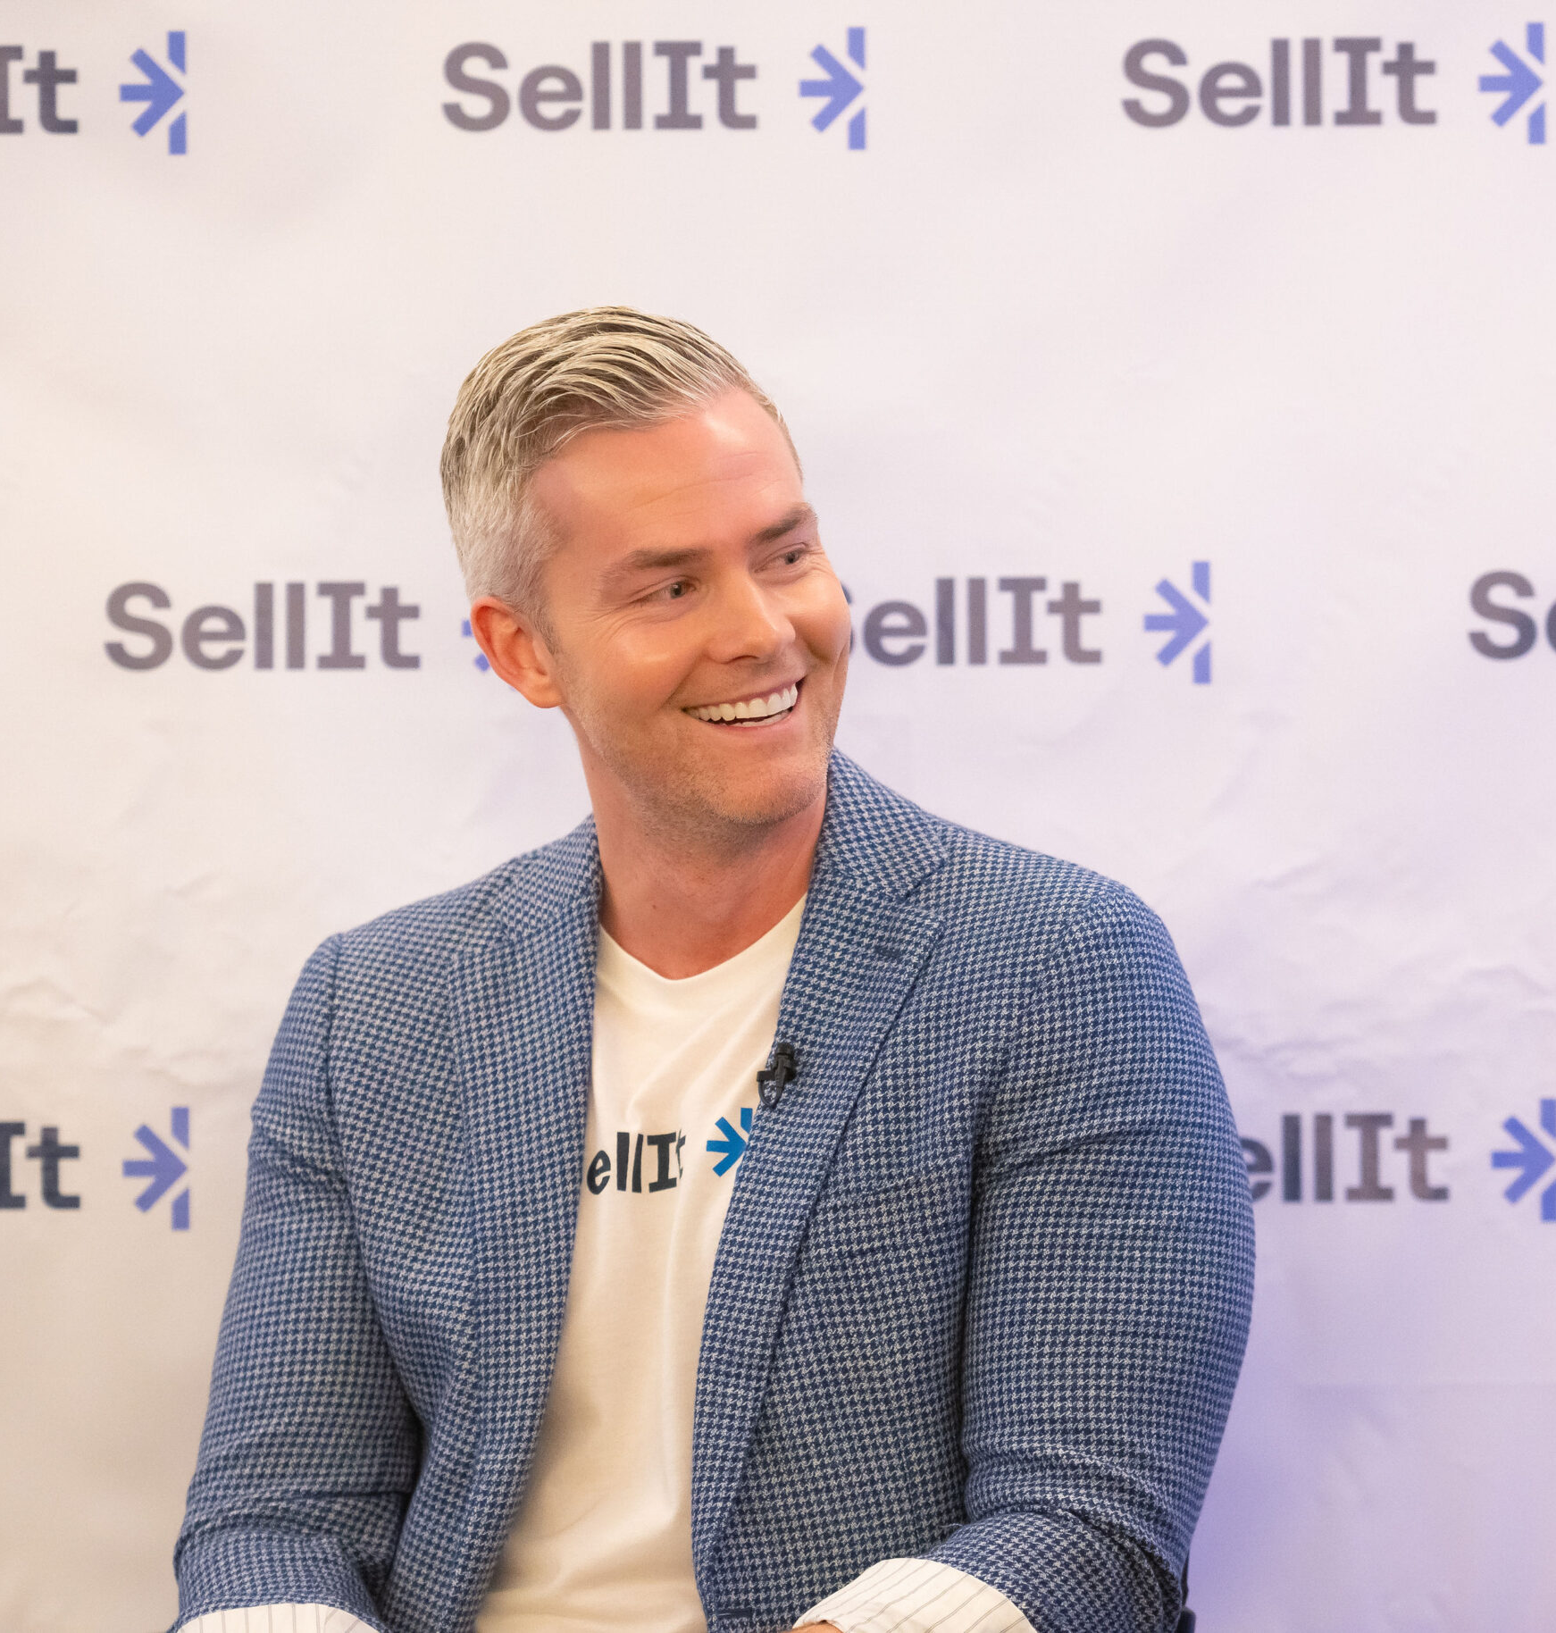
GLOBAL BENCHMARKING
1. SELL IT
by Ryan Serhant
EDGE
VULNERABILITY
Brand Power & Celebrity Influence
High Production Value
Community of global agents
Excellent Subscription Model
US-Centric, lacks compatibility with regional laws or customs.
Expensive for many markets.
Lacks formal accreditation.
Limited hands-on trainings
REVENUE MODEL
DELIVERY MODEL
Subscription-Based Membership
Upgraded Training Options (Live events tickets, 1:1 coaching, etc.)
Affiliate & Partnership Revenue
Merchandise and book sales
Online platform & mobile app:
Online courses.
Live weekly workshops
Plus tier small group coaching
EMPOWERING BUSINESSES

Slide 7

GLOBAL BENCHMARKING
2. TOM FERRY INTERNATIONAL
by Tom Ferry
EDGE
VULNERABILITY
Established 15+ Brand Reputation
Tech Integrations (CRM)
Scalable Tiers (all levels)
Offers full-spectrum training
Focused on high-producing agents
U.S.-Centric Content
Too broad coverage
Some reviews say “too theoretical”.
REVENUE MODEL
DELIVERY MODEL
Subscription-Based Membership
Upgraded Training Options (Live events tickets, 1:1 coaching, etc.)
Affiliate & Partnership Revenue
Agents’ sales (Ferry’s CRM).
Virtual coaching , online library& community:
Core and elite coaching.
Large events
Online courses
EMPOWERING BUSINESSES

Slide 8

GLOBAL BENCHMARKING
3. KAPLAN EDUCATION
EDGE
VULNERABILITY
Brand Authority & Trust
Accreditation & Compliance
Various& Flexible Learning Formats
Institutional reach and B2B Partnerships
Impersonal & too transactional
Outdated Content delivery
US only focused courses.
falling behind tech-forward competitors
REVENUE MODEL
DELIVERY MODEL
Core pre-licensing courses.
B2B Brokerage Packages
Accreditation Partnerships (white labeling).
Pre-Licensing Courses and exam prep tools.
Continuing Education (CE)
Brokerage Solutions (training for firms)
EMPOWERING BUSINESSES

Slide 9

GLOBAL BENCHMARKING
4. Property Academy UK
by Property Genius
EDGE
VULNERABILITY
Hybrid Learning Model
Tiered Genres (Free, premium& high)
Localized for UK/EU Markets
Community & Accountability (Slack)
Tech Integration (Built-in CRM)
Niche Focus – only residential
No Celebrity Power
Weak on Compliance
Geographic Limitation (EU market)
REVENUE MODEL
DELIVERY MODEL
Subscription-Based Membership
Upgraded Training Options (Live bootcamps, 1:1 coaching, etc.)
Affiliate Revenue (ex. CRM tool)
Corporate partnerships
Sales & Lead Generation Training
Core and elite coaching.
Tech Tools (CRM& Lead tracker)
Community & Coaching
Free Webinars and podcasts to upsell paid content
EMPOWERING BUSINESSES

Slide 10

GLOBAL BENCHMARKING
Good aspects to focus on
Celebrity Power& Hype: makes it relevant to people (Sell It).
Simple, Actionable scripts& templates: acts like a “cheat code” for sales (Sell It).
Tiered Learning System: Suitable for all levels “Free Content -> mid-tier -> high end coaching”, (Tom Ferry – Property Academy UK).
Data-Driven Accountability: Tracks KPIs (e.g., calls made, deals closed) – No guesswork. “You made 50 calls but only 1 appointment? Let’s fix your script.” (Tom Ferry).
Accreditation & Compliance: Courses/licenses are recognized (Kaplan Education).
Flexible Formats: Offers on-demand, online, and in-person classes (Kaplan Education).
Localized Sales Training: UK-specific scripts/tools (proves deep market understanding). (Property Academy UK).
by Basem El-Sherbiny
EMPOWERING BUSINESSES

Slide 11
GLOBAL BENCHMARKING
Vulnerabilities to avoid
No Accreditation: makes the agent hesitant on the value of the course (Sell It).
Avoiding localization: prevents Etqan from becoming "just another U.S. clone." (Sell It).
Overwhelming for Beginners: Content is geared toward top producers, leaving new agents behind. (Tom Ferry).
Tiered pricing: Elite programs ($10K+/year) price out small-scale agents. (Tom Ferry).
Impersonal, Transactional Learning: No coaching/mentorship; just pre-recorded lectures and textbooks. (Kaplan Education).
Outdated Content Delivery: Relies on dull videos and PDFs (Kaplan Education).
No Investor Training: Focusing solely on residential sales. (Property Academy UK).
by Basem El-Sherbiny
EMPOWERING BUSINESSES

Slide 12

EGYPTIAN COMPETITION
Coldwell Banker Egypt
Who Are Coldwell Banker Egypt?
Coldwell Banker Training Academy is considered one of the specialized institutes in Egypt that offers Real Estate education development and this should help Egypt build their leaders of tomorrow and create a deeper pool of talents in the Real Estate sales field. These courses are designed to offer all candidates interested in Real Estate sales a greater insight into the profession of selling and closing deals. Coldwell Banker Courses are delivered by professionals with over 10 years’ experience in real estate, the courses consists of both theoretical and practical elements of the real estate sales process with the emphasis on negotiations and closings.
Offering | Period | Price
Professional Real Estate Course | 3 days
Professional Real Estate Certificate | 4 days
Real Estate Leadership Certificate | 2 days
Managerial Course | 1 day
Real Estate Essentials Mini Diploma | 10 days
Mini Real Estate Diploma | 5 days
What do they offer?
EMPOWERING BUSINESSES

Slide 13
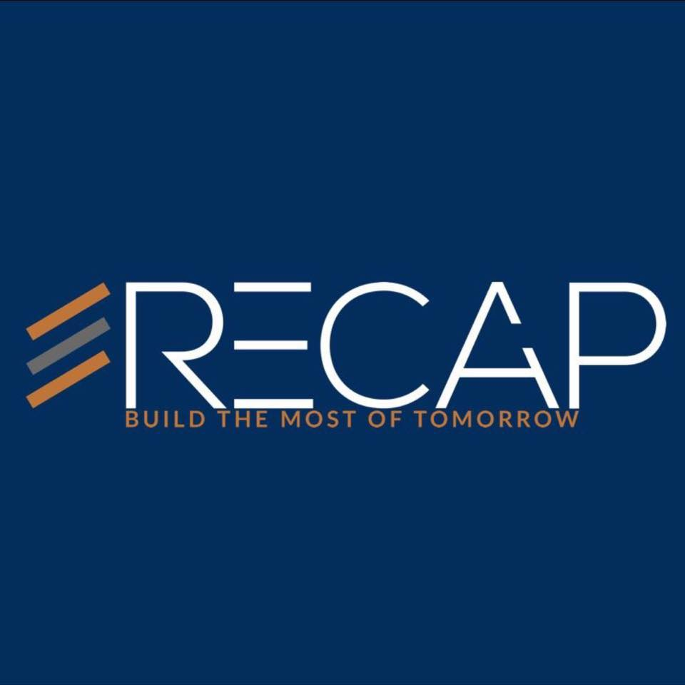
EGYPTIAN COMPETITION
RECAP ACADEMY
Who Are RECAP?
RECAP is a market leader in the Real Estate Education Industry, providing high-quality services and expertise in real estate investment and development. Established in 2014, RECAP has conducted training for over 400 real estate companies, positioning itself as a trusted business consultant and real estate academy. Our Real Estate Academy offers a comprehensive range of training programs that are tailored to meet the industry's ever-changing needs. We cover key topics such as Real Estate Sales, Marketing, Investment, Commercial, Human Resources, Call Centre, Customer Service, Leasing, and Property Management. Our aim is to elevate the standards of the industry by providing focused training that matches the market need.
Prices As of late 2024
Offering | Period (one day per week) | Price | Key Contents
Real Estate Licensing Prep | 3 Weeks | 5,000 - 7,000 EGP | Exam prep, Egyptian laws, brokerage selection
Sales Agent Accelerator | 6 Weeks | 8,000 - 12,000 EGP | Lead gen (FB/WhatsApp), negotiation, contracts
Property Management Certification | 8 Weeks | 10,000 - 14,000 EGP | Tenant relations, maintenance, financials
Luxury & Off-Plan Sales Mastery | 8 Weeks | 15,000 - 20,000+ EGP | High-net-worth client tactics, developer deals
Digital Marketing for Real Estate | 4 Weeks | 7,000 - 10,000 EGP | FB/Google Ads, social media farming
Source: Social Media/Student Testimonials.
EMPOWERING BUSINESSES

Slide 14
EGYPTIAN COMPETITION: Important notes
Perception: Recap positions itself as a "global-standard" academy with Prices are ~40-60% higher than local competitors.
Hidden Cost: Exam fees (EGP 1500 – 3000) / Gold Package and 1:1 Coaching (EGP 5000+).
Discount Tactics: Early bird discounts – corporate bulk deals discounts.
Franchise-Driven Model: Courses often require signing with a CB-affiliated brokerage, while "Standalone" training is rare.
Hidden Cost: Franchise fees/tech stack access.
Corporate Discount Dominance: Brokerages get 15–25% off for team sign-ups (5+ agents).
Tech Bundle Costs: Access to CB’s proprietary tools (e.g., CRM, marketing templates) adds +5,000–10,000 EGP.
EMPOWERING BUSINESSES

Slide 15
SWOT Analysis: Egyptian Highlighted Competition
RECAP Academy (Egypt) A private real estate academy and consulting firm that has become a market leader in real estate education in Egypt. RECAP offers a comprehensive range of programs tailored to industry needs. RECAP often partners with developers and brokerages to deliver customized in-house training; for example, it teamed up with V Developments.
STRENGTHS
WEAKNESSES
Custom B2B training for developers, and is seen as the “go-to” for corporates.
Advanced Curriculum and courses, such as Commercial Director Diploma.
Evening classes: 6-9 fits with working professionals.
No Hybrid Options (In-person only)
Niche Overreach “might scare beginners”.
Course might be expensive (ex. EGP 10,000) if not backed with a reliable certificate.
Too many courses (Variety).
Opportunities
THREATS
Underprice Advanced Diploma (18k).
Add Online Flexibility.
Steal RECAP’s developer clients with lower-cost stronger trainings (B2B).
RECAP’s LinkedIn/Instagram presence attracts corporates. That needs to be outperformed.
High prices = perceived as "elite“ and filters audience.
Example: RECAP’s EGP 18K Commercial Director Diploma feels like a "must-have" for aspiring professionals.
EMPOWERING BUSINESSES

Slide 16
SWOT Analysis: Egyptian Highlighted Competition
Coldwell Banker Training Academy Coldwell Banker’s academy provides short courses and “mini-diplomas” for agents at various levels. These courses combine theoretical and practical elements with an emphasis on negotiation and closing skills. Coldwell Banker leverages its brand and 20+ years in Egypt to attract both new and experienced agents.
STRENGTHS
WEAKNESSES
Brand Power & Legacy: 20+ years and “Mini-Diploma” branding adds value.
Courses drill closing tactics & leadership (not just theory).
Trains agents to align with Coldwell Banker’s brokerage standards.
EGP 3,900 for 1 day (~$125) is a bit much for newbie agents
requires physical attendance (New Cairo/Alexandria).
More oriented to brokerages not individuals.
Focus on "future leaders" may rebel rookie agents needing basics.
Opportunities
THREATS
(1-day workshops + recorded access) Could be underpriced.
Offer more variety for courses.
Do better with individuals’ courses
Agents may train with Coldwell to join their brokerage network.
Their "mini-diploma" branding outshines generic certificates.
Physical branches in New Cairo/Alexandria are key hubs.
EMPOWERING BUSINESSES

Slide 17
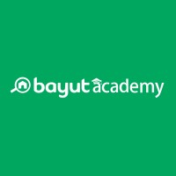
SWOT Analysis: Egyptian Highlighted Competition
Bayut Academy provides free real estate agent training workshops as a value-added service. The academy runs periodic sessions led by expert trainers from UAE. Content spans from communication skills and phone etiquette to client psychology, sales techniques for closing deals, and industry insider tips.
STRENGTHS
WEAKNESSES
Free High-Quality Training, attracting 90+ agents/session.
Brand Credibility: backed by Bayut.com flowing instructors from UAE.
Networking Hub: Agents also join for peer connections as much as training.
No Local Accreditation: completion-only certificates, not EREF-approved.
Limited Advanced Content: focus only on introductory skills (ex. No brokerages).
Foreign-Centric Examples: instructors might use UAE based examples.
Opportunities
THREATS
Offer EREF-recognized micro-certs even in free workshops
Teach Egyptian contract laws, New Capital/North Coast market tactics.
Add paid masterclasses on REITs, developer negotiations
“Free” is the hardest price to beat. Even if your courses are better.
Agent Loyalty & Networking: Agents bond at Bayut.
Bayut can flood Facebook, Instagram, and Google with ads for their free workshops.
EMPOWERING BUSINESSES

Slide 18

SWOT Analysis: Egyptian Highlighted Competition
AUC School of Business – Real Estate Programs offers executive education certificates and short courses in real estate through its Onsi Sawiris School of Business. These programs are more academic in nature, targeting professionals who seek formal certificates in areas like Real Estate.
STRENGTHS
WEAKNESSES
Academic Prestige: AUC’s brand and certificate carry elite recognition.
Structured Curriculum: Covers interdisciplinary topics and Includes field visits to companies (rare).
Evening/weekend blended learning (live-online + in-person)
High Cost, EGP 18,000+ for certificates (~$600+) prices out many agents.
Lacks practical sales training (e.g., negotiation scripts, lead gen).
Courses update annually (vs. industry academies’ monthly updates).
Opportunities
THREATS
Try to offer “AUC-Level Theory + Our Sales Bootcamp” bundles.
Underprice Certifications.
Market to professionals who can’t afford AUC but want structured learning.
AUC’s certificates are resume boosters for corporate roles.
AUC collaborates with developers (e.g., SODIC, Orascom).
EMPOWERING BUSINESSES

Slide 19
Market Gaps Identified: Highlighted Egyptian Competition
Bayut: Free workshops but no accreditation or advanced content.
Coldwell/RECAP/AUC: relatively low ROI vs. price.
AUC: Strong theory but zero sales training – high fees
RECAP: Practical but too niche/expensive.
Competitive edge might be:
Better Pricing: Not the cheapest, but the most justified.
Stronger Trust Signals: Industry-backed certs > bureaucratic stamps.
Hybrid Convenience: Learn anytime, anywhere (unlike rigid competitors).
Next Steps:
Brokerage Partnerships & Placement.
Turn graduates into case studies to attract new students. (story-telling).
Build trusted channels for hybrid options that are professional and reliable.
EMPOWERING BUSINESSES

Slide 20
JUSTIFIED PREMIUMS
1
Pricing Strategy – Don’t compete on price—compete on Perception and ROI.
WORKSHOP:
A free workshop for lead generation & Trust building, that would prove immediate value.
Course:
For a certain skill building - establishing a paid community, solve pain points and teach actionable systems.
Certificate:
For credibility – for career advancement to facilitate job placement, adding industrial credentials.
Diploma:
For Elite tier – for industry leadership targeting established agents/broker and creating industry influencers.
WORKSHOP
COURSE
CERTIFICATE
DIPLOMA
DD/MM/YYYY
Feature Name/Product
Your Company Name

Slide 21
JUSTIFIED PREMIUMS
1
Pricing Strategy – Keep them stranded!
TIER | FORMAT | PRICE | CONVERSION STRATEGY
Workshops | 2-3 hours (in-person) Quarterly | Free | Loved these Workshop? Master all the tools in our Course (25% discount if you enroll today!)
Courses (2-4) | 2-4 weeks (Live online sessions + recordings + WhatsApp group) | EGP 3500 - 7000 | Ready to get certified? 83% of grads boost income with our Certificate program!
Certificates (2 choices) | 2 Months Hybrid (Online + 2 in-person sessions) | EGP 10000 - 14000 | Turn course grads into certificate students by proving career ROI.
Diplomas (2 choices) | 4 Months Weekly Hybrid Classes + Market proved internship/project | EGP 22000 - 28000 | Position diploma as the ultimate industry advantage for elite brokers.
DD/MM/YYYY
Feature Name/Product
Your Company Name

Slide 22
STRONG CRIDIBILITY
2
Accreditation roadmap – balancing credibility, speed-to-market, and local trust signals.
1- Developer & Brokerage Co-Branding
2- Industry Association Validation
3- International Endorsements
Partner with major Egyptian developers/brokerages to issue joint certificates.
Target mid-sized developers – they’re more agile.
Offer free training to their sales teams in exchange for co-branding
According to ECRA – Egyptian agents value developer affiliation over government certs.
Issues Egyptian Real Estate Brokers Association "EREBA-Approved Training" stamps.
Submit course outlines to EREBA’s education committee.
Pay ~ EGP 10,000/year for auditing/membership.
Host 1 joint webinar/year with EREBA.
FIABCI Egypt :
"FIABCI-Endorsed Real Estate Diploma“
FIABCI requires local board membership (~EGP 15K/year). Benefit: Attracts agents targeting expat/dollar-based clients.
NAR Global (U.S. National Association of Realtors):
Certified International Property Specialist (CIPS) prep courses.
License prep content from NAR ($5,000–$10,000/year).
DD/MM/YYYY
Feature Name/Product
Your Company Name

Slide 23
STRONG CRIDIBILITY
2
Accreditation roadmap – balancing credibility, speed-to-market, and local trust signals.
Execution Plan: Year 1
Month 1–3: Secure 2 developer co-branding deals (Mid-Tier).
Month 4–6: Partner with EREBA for "Approved Training" status.
Month 7–12: Launch FIABCI-endorsed courses for luxury market agents.
Next steps:
Draft a co-branding proposal for Mid-tier developers. “Agents”
Contact EREBA’s training director for “Approved Training” Status. “Brokers”
Design certificate templates with partner logos.
DD/MM/YYYY
Feature Name/Product
Your Company Name

Slide 24
KEEP IT RECURRING
3
Client keeping Strategy – Ideas Beyond Just courses.
Type | Price | Description
White-labeled CRM | EGP 500/Month | A white-labeled CRM with WhatsApp automation, Arabic templates, and EGP commission tracking. Bundled free for 3–6 months with premium courses, then converts to paid.
1:1 Live coaching | ~EGP 1000 / One time | Fits Egypt's "I need help now!" culture. Hiring part-time coaches to coach agents weekly
B2B retainer trainings | Option 1: ~25K/Month Option 2: ~2% Gross Sales | Custom workshops for developers/brokerages (e.g., “Train Your Sales Team on Off-Plan Tactics”).
DD/MM/YYYY
Feature Name/Product
Your Company Name

Slide 25
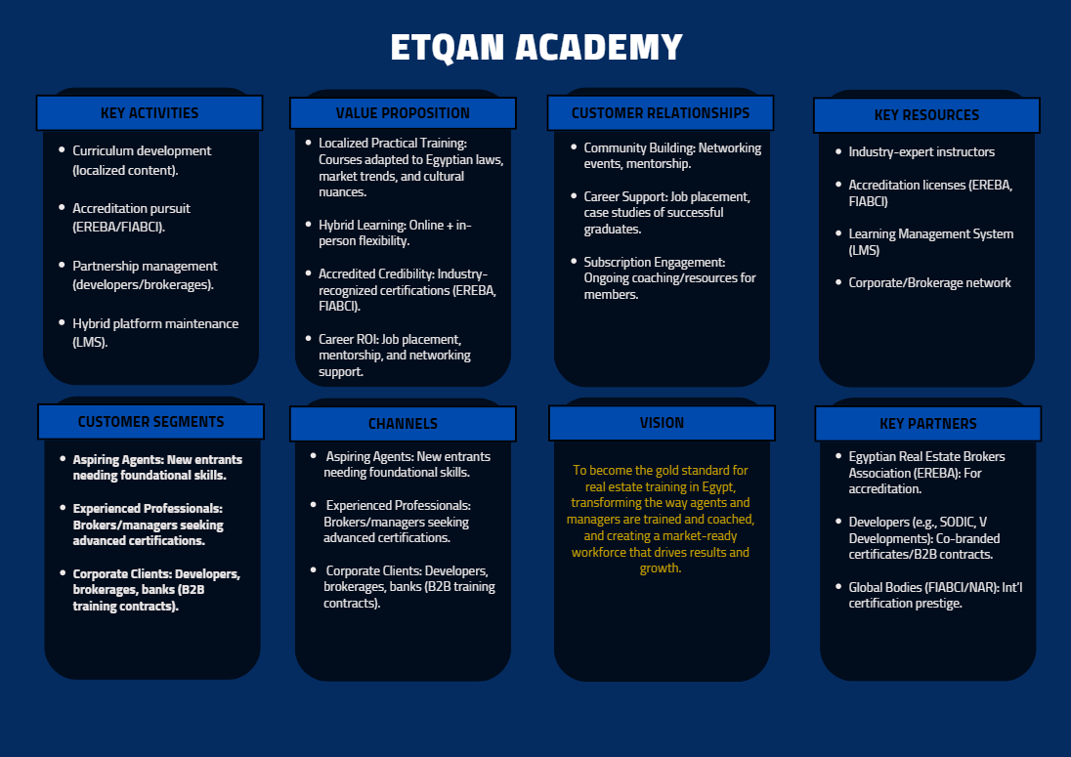
DD/MM/YYYY
Feature Name/Product
Your Company Name

Slide 26
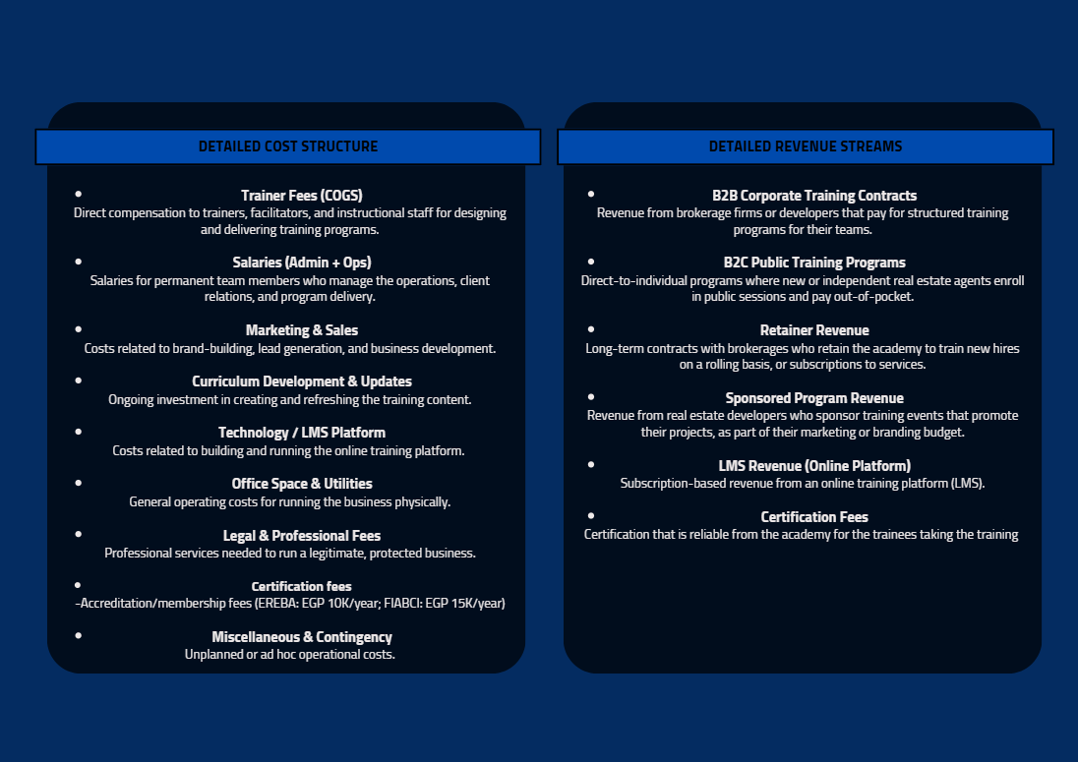
DD/MM/YYYY
Feature Name/Product
Your Company Name

Slide 27

GO-TO-MARKET TIMELINE
Initiative | Objective | Q1 |  |  | Q2 |  |  | Q3 |  |  | Q4
Foundation & Strategic Alignment | Finalize Partnership, Define Pricing Model, and Establish Brand Identity
Pilot & Proof of Concept | Launch B2B Pilot Programs with Key Brokerage Partners
Market Activation & Demand Generation | Roll Out Public Program Calendar and Launch Paid Acquisition Campaigns
Digital Launch & Corporate Scaling | Release Online Learning Prototype and Expand Corporate Offering Packages
EMPOWERING BUSINESSES

Slide 28
FINANCIAL PROJECTIONS
2
Analysis: Year 1
Tier | Conversion Rate | Student/Year | Estimated Revenue
Workshops | - | 1000 | EGP 0
Courses | 20% of Workshop grads | 200 | EGP 1,000,000
Certificates | 25% of Course grads | 50 | EGP 600,000
Diploma | 20% of Certificate grads | 10 | EGP 250,000
TOTAL |  | EGP 1,850,000
Tier | Subscribers | Rev/Client | Estimated Revenue
CRM Subscriptions | 100 (6) | EGP 500 | EGP 30,000
1:1 Coaching | 40 (3) | EGP 1000 | EGP 120,000
B2B Retainers | 6 | EGP 150,000 | EGP 900,000
TOTAL |  | EGP 1,050,000
DD/MM/YYYY
Feature Name/Product
Your Company Name

Slide 29
CONCLUSION – The Strategic Bet
This is more than a training business—it’s a market transformation initiative.
Multi-revenue model: B2B contracts, public programs, retainers, LMS.
Profitable from Year 1, scalable digitally from Year 2.
Flexible, modular design for diverse brokers and developers.
Built to set a national benchmark and unlock regional growth.
We don’t follow industry standards. We build the new norm!
EMPOWERING BUSINESSES

Slide 30

Thanks

